Slide 1
My Killer Presentation

Slide 2
Page 1
Page one of my presentation

Slide 3
Page 2
Page two of my presentation

Slide 4
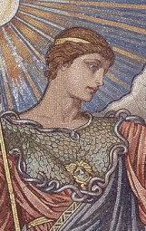
Minerva

Slide 5
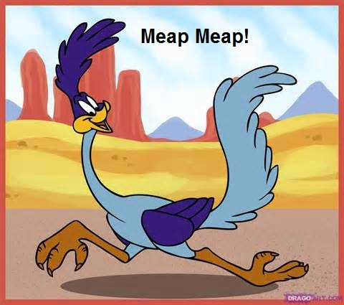
Meap Meap!

Slide 6
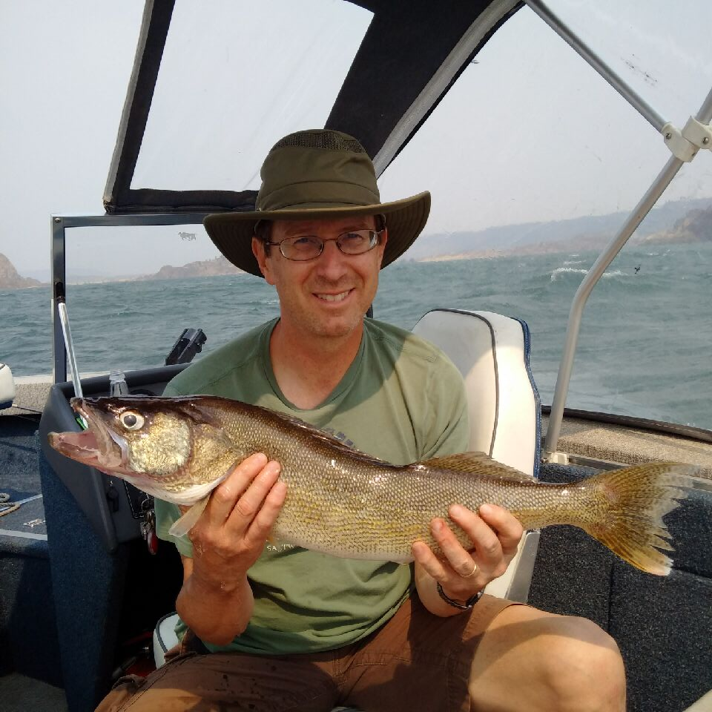
The Big Fish

